Slide 1
Tables & figures
Technical reading, W3

Slide 2
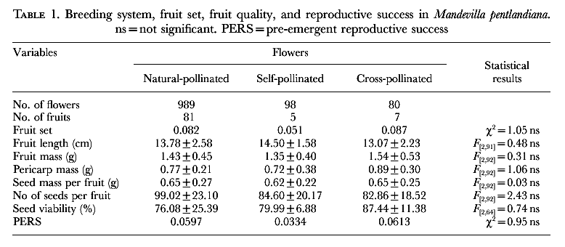
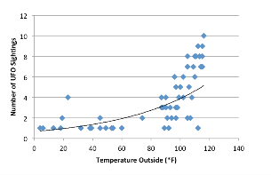
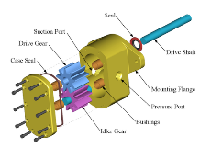
Tables and Figures
In addition to main text, a technical document often includes display items to better illustrate the ideas and information:
Tables
Figures
Graphs: line chart, bar chart, scatter plot
Diagrams: UML, sys arch, ER diagram
Images: photos
Maps
Schematics

Slide 3
Tables and figures in skimming
Readers usually read the tables and figures in skimming
Readers expect to find important topics discussed in tables and figures
Tables and figures should be self-explanatory, yet the main text should introduce the display items where appropriate

Slide 4
Outline
Tables
Table structure. How to read tables.
When to use?
Incorporate tables to main text
Figures (in particular, graphs)
When to use. Parts of a figure
Incorporating figures into main text
Bar graph
Line graph
Scatter graph

Slide 5
Tables
A table is a grid of data in rows and columns. It contains …
Table caption (aka legend)
Placed above the body of table
Descriptive, or story telling. Helps the readers to understand the table without referring to the main text
Column header (aka title or label)
Short and descriptive, include units
Define or identify the content of a column
Row header
Similar to column header
Interpret the data in table body w.r.t. the row and column headers

Slide 6
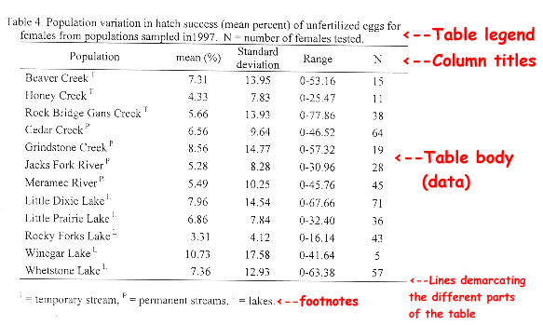
Table caption
Column header
Table body
Notes:
http://abacus.bates.edu/~ganderso/biology/resources/writing/HTWtablefigs.html

Slide 7
When to use a table
Show many and precise numerical values in a small space
Compare / contrast values or characteristics of items that are related or that share several characteristics or variables
Show the presence or absence of specific characteristics
Notes:
https://www.editage.com/insights/choose-the-best-format-for-presenting-your-research-data-tables-figures-and-text

Slide 8
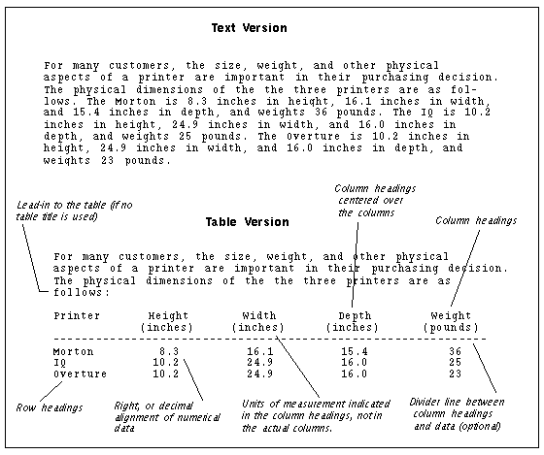
Notes:
https://www.tu-chemnitz.de/phil/english/sections/linguist/independent/kursmaterialien/TechComm/acchtml/graphics.html

Slide 9
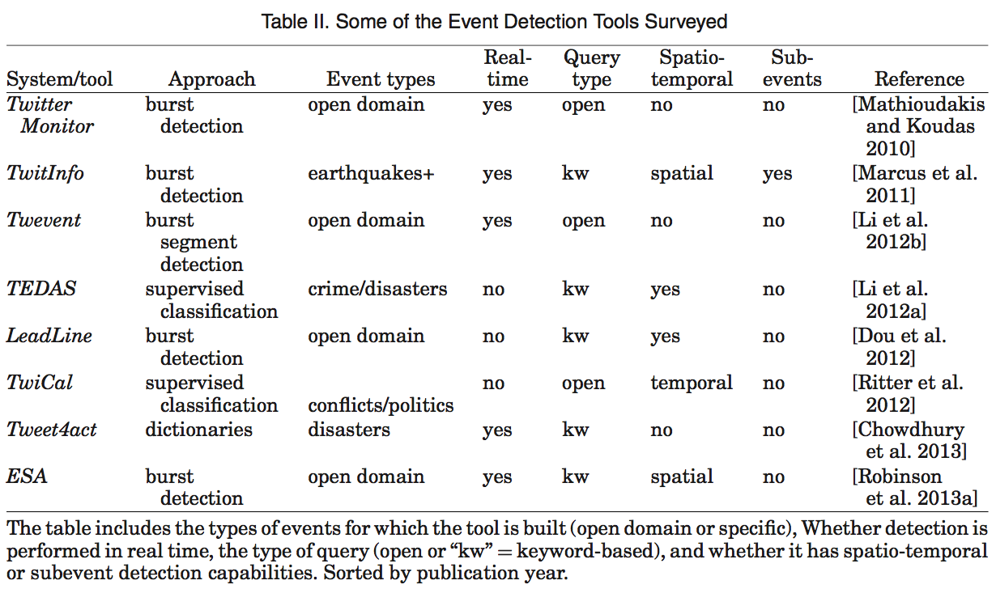
From Imran (2015) Processing social media messages in mass emergency: A survey, ACM Computing Surveys
Notes:
Imran 2015, Processing Social Media Messages in Mass Emergency: A Survey, ACM Computing Surveys

Slide 10
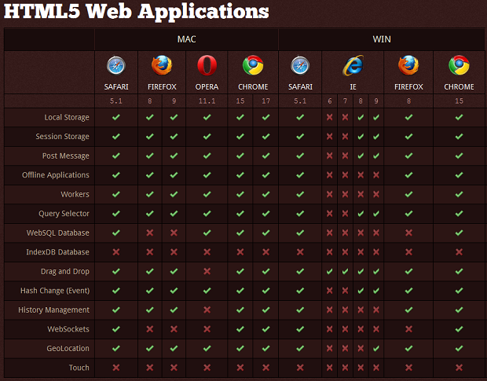
Notes:
https://speckyboy.com/getting-to-grips-with-html5-browser-compatibility/

Slide 11
Refer to your tables
The main text should
Tell the reader when to look at a table
Introduce the content of the table
Point out any key features or trends which the reader should take a note of
Highlight analysis or findings, summarizing only important details rather than reiterating the entire table
Draw a conclusion from the table which answers “So what?” questions
Notes:
Distribute the note 1-effective-use-tables-figures.pdf

Slide 12
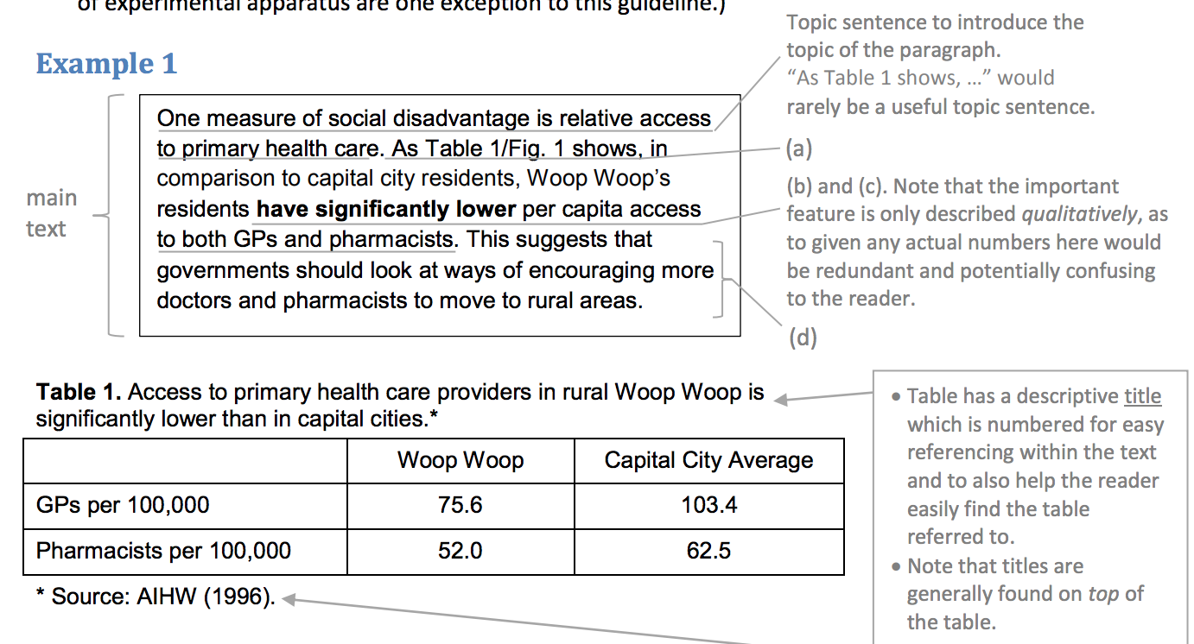
Notes:
http://uq.edu.au/student-services/pdf/learning/effective-use-tables-figures.pdf

Slide 13
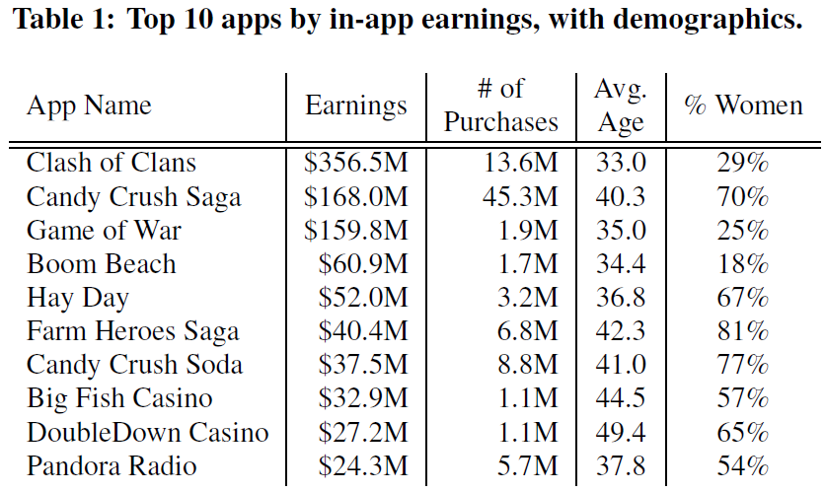
From Kooti (2017) iPhone’s digital marketplace: characterizing the big spenders
Read the paragraph that refers to the table on page 15. How does it introduce the table? What key features of the data are noted?

Slide 14
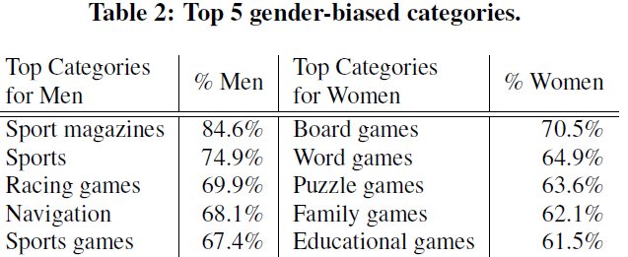
From Kooti (2017) iPhone’s digital marketplace: characterizing the big spenders
Read the paragraph that refers to the table on page 15. How does it introduce the table? What key features of the data are noted?

Slide 15
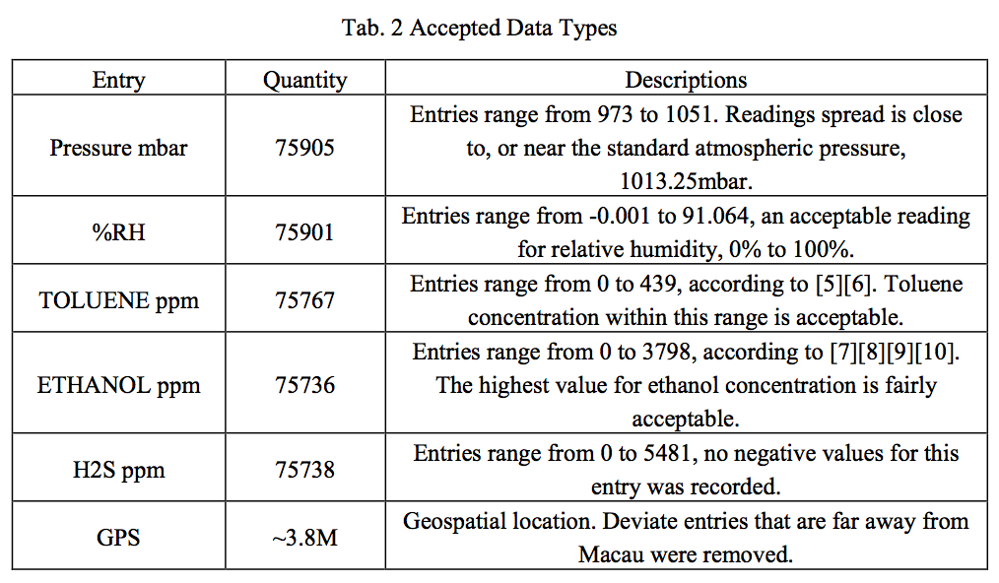
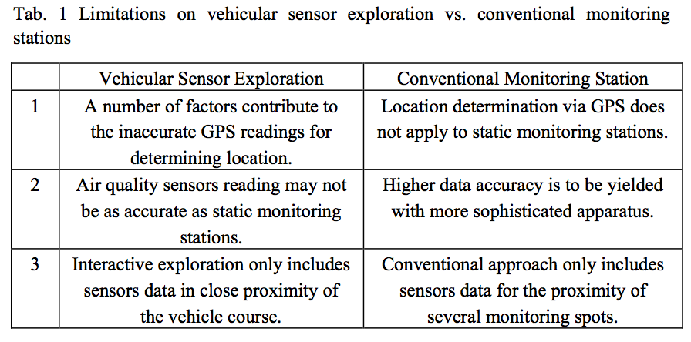
Exercise
Read the tables 1 and 2 of the CEIE paper
What is the purpose of the two tables?
Read how the main text refers to the tables. Comment.

Slide 16
Reference on tables
Markus’ Small guide on writing nice tables
https://www.inf.ethz.ch/personal/markusp/teaching/guides/guide-tables.pdf
Advices of more complicated tables (and figures)
https://dl.sciencesocieties.org/files/publications/style/chapter-05.pdf

Slide 17
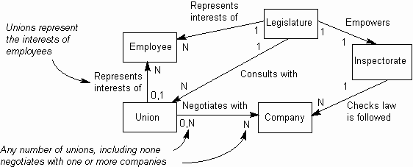
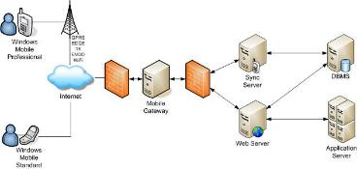
Figures
In academic papers, figures include anything that is not main text or tables
A figure is any visual depiction of something
A chart or graph shows numerical relationships, e.g. line chart, scatter plot, bar graph
A diagram is a visual representation of a structure of a process
May also be photos, schematics, maps, etc.
Notes:
https://www.quora.com/Whats-the-difference-between-Chart-Graph-Figure

Slide 18
When to use a figure
Visually explain a sequence of events, phenomena, characteristics, or geographical features
E.g. system architecture, UML activity diagrams
Show trends, patterns, and relationships across and between data sets, when the trend is more important than the precise data values
E.g. bar graphs, line graphs, scatter graphs

Slide 19
Why graphs?
Figures can convey information about complex data sets quickly and effectively
Take advantage of the our ability to recognize visual/spatial patterns and to quickly change focus from the big picture to small details

Slide 20
Goals of using a graph
Document the data (often a graph is the only place the data gets published)
Make comparisons (such as displaying trends)
Allow for inferences of cause and effect
Tell a story
Integrate with the text to enhance the overall communication of the paper

Slide 21
Parts in a graph (figure)
Caption (aka legend)
Describe everything in the graph
Draw attention to its important features
Describe the main conclusions to be drawn
X-axis, Y-axis: labels and ticks
Data: symbol (and key), lines

Slide 22
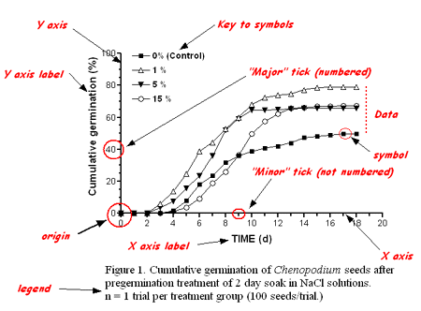
Notes:
Almost Everything You Wanted to Know About Making Tables and Figures
http://abacus.bates.edu/~ganderso/biology/resources/writing/HTWtablefigs.html

Slide 23
Refer to your figures
The main text should
Tell the reader when to look at a figure
Introduce the content of the figure
Point out any key features or trends which the reader should take a note of
Highlight analysis or findings, summarizing only important details rather than reiterating the data in figures
Draw a conclusion from the table which answers “So what?” questions
Notes:
Distribute the note 1-effective-use-tables-figures.pdf

Slide 24
How to read a bar graph
Bar graphs are used to compare the value of a single variable among several groups
X-axis: groups, categorical variable
Different bar fill color defined in a key is used to show a second categorical variable
Y-axis: the measured variable, axis labels with unit
Length of bars represents the magnitude of value. Usually start value of y-axis = 0

Slide 25
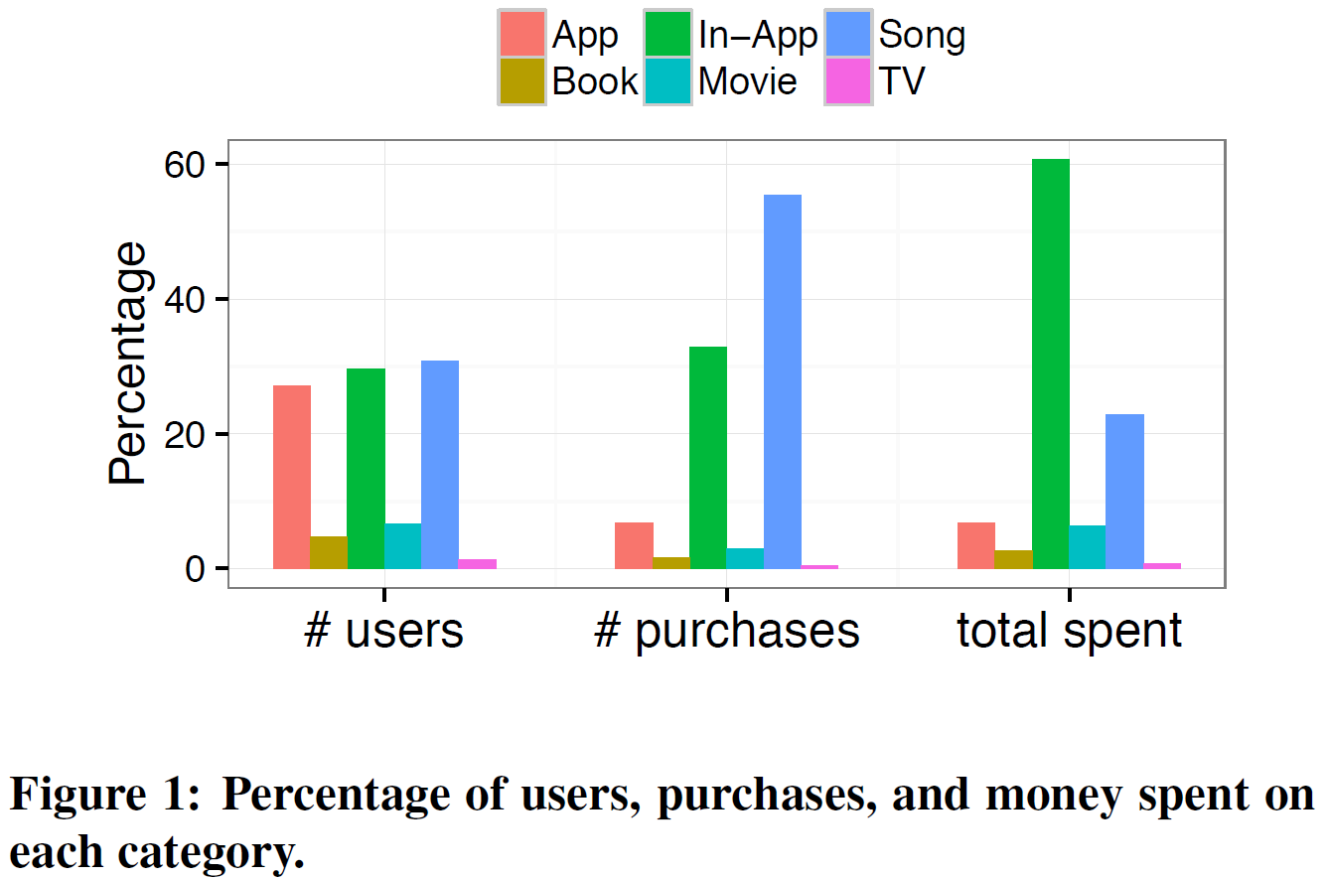
From Kooti (2017) iPhone digital marketplace, p. 14.
What can you learn from the bar charts?
Read the paragraph that refers to the figure in the paper
Notes:
3-Kooti 2017 - iPhone digital marketplace
p. 14

Slide 26
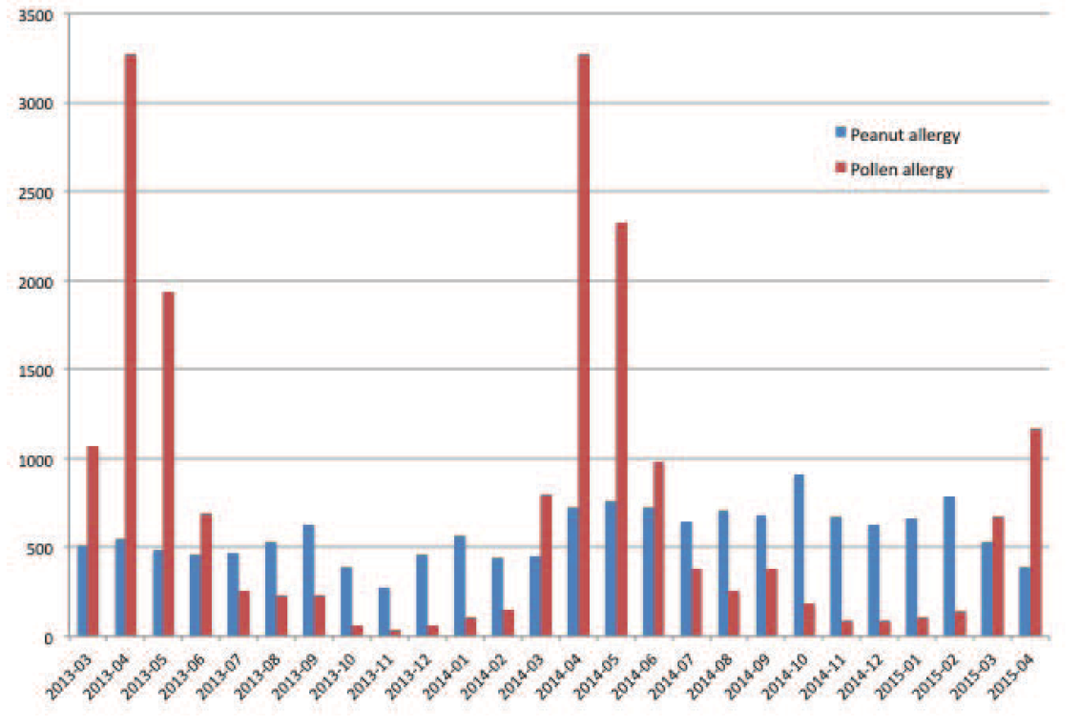
Fig 3: Monthly distribution of mentions of peanut and pollen allergies (March 2013-April 2015). A huge seasonal variation is observed in monthly pollen allergy (a seasonal allergy) level compared to that of peanut allergy (a good allergy).
From Lee (2015) Mining social media streams to improve public health allergy surveillance

Slide 27
How to read a line graph
Line graphs plot a series of related values that depict a change in Y as a function of X
Often used in two cases:
track changes of a value over time, e.g. temperature in a period
Plot the trend of a measured value in different choice of a control variable, e.g. time spent to sort an array of size N
Can compare the trend of several variables
May also be used when there are too many data points for bar graphs

Slide 28
Fig 1. Time-series graph of daily allergy levels detected in tweets (Feb 2013 – Apr 2015). Only those allergy-related tweets labeled as positive are used to create the graph. The graph illustrates the general allergy level trend over time. The allergy level is the highest in mid-May, goes down in June and July, starts rising again in August, and reaches its local maximum point in mid-September. Similar seasonal pattern is observed in both 2013 and 2014.
From Lee (2015) Mining social media streams to improve public health allergy surveillance

Slide 29
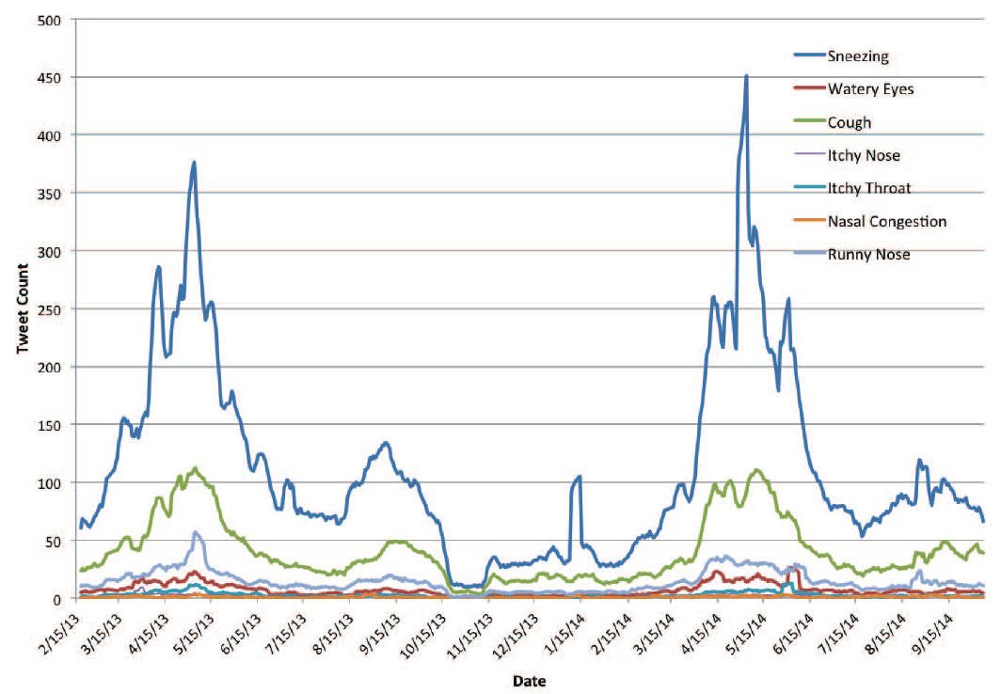
Fig 4. Time-series graph of tweet count for various allergy symptoms (Feb 2013-Sep 2014). The most common allergy symptom is sneezing (blue line) throughout the year, followed by cough (green) and runny nose (sky blue)
From Lee (2015) Mining social media streams to improve public health allergy surveillance

Slide 30
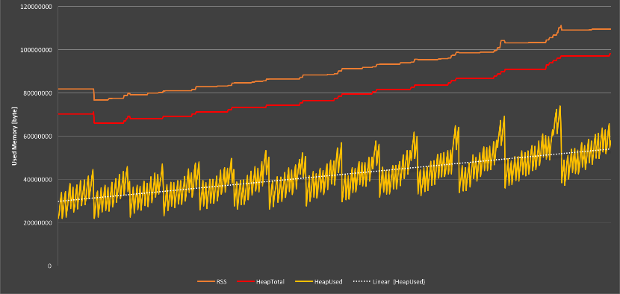
A sawtooth pattern with these vertical drops coinciding with garbage collection may also indicate a memory leak.
Credit: https://medium.com/outsystems-experts/beyond-memory-leaks-in-javascript-d27fd48ae67e

Slide 31
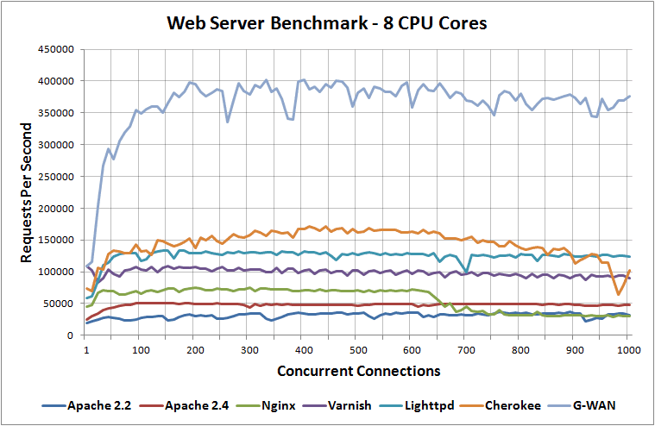
This figure shows the number of requests a web server can serve per second as more concurrent connections arrive at the web server. The x-axis is the independent variable (the author controls the #connection in the benchmark). The y-axis is the measured value of the server’s performance.
Credit: https://www.rootusers.com/web-server-performance-benchmark/
Notes:
https://www.rootusers.com/web-server-performance-benchmark/

Slide 32
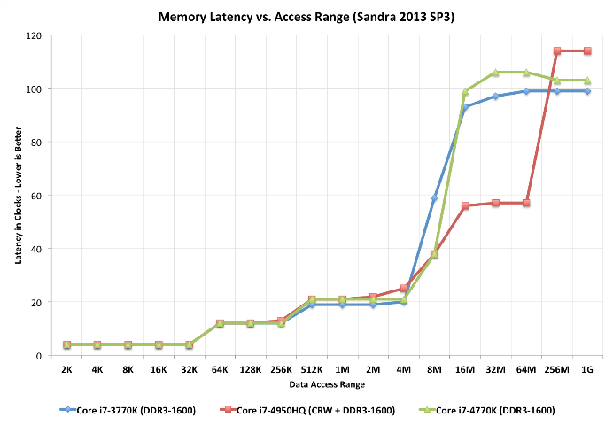
This chart from Anandtech’s Haswell review is useful because it actually illustrates the performance impact of adding a huge (128MB) L4 cache as well as the conventional L1/L2/L3 structures. Each stair step represents a new level of cache. The red line is the chip with an L4 — note that for large file sizes, it’s still almost twice as fast as the other two Intel chips.
Credit: https://www.extremetech.com/extreme/188776-how-l1-and-l2-cpu-caches-work-and-why-theyre-an-essential-part-of-modern-chips
Notes:
https://www.extremetech.com/extreme/188776-how-l1-and-l2-cpu-caches-work-and-why-theyre-an-essential-part-of-modern-chips

Slide 33
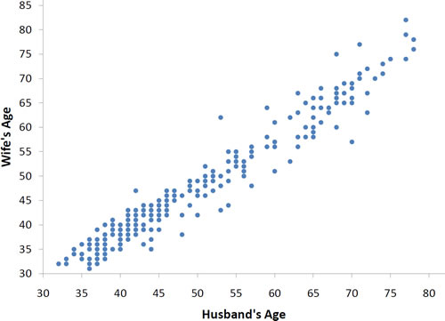
Scatter plot
A scatter plot shows two variables of a set of data points. It can reveal pattern and correlation
Each data point refers to a couple (husband and wife)
What pattern can you see from the graph?
Any outliners (exception to the pattern)?
Notes:
http://onlinestatbook.com/2/describing_bivariate_data/intro.html

Slide 34
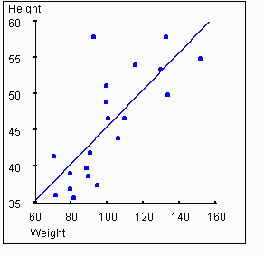
Correlation
This figure shows high correlation between height and weight of a person. If the height of a person is large, then you can expect their weight is also large.
A regression line passes through the center of a scatter plot.
In case of high correlation, the data points fall near the regression line.
Notes:
https://simon.cs.vt.edu/SoSci/converted/Correlation/activity.html

Slide 35
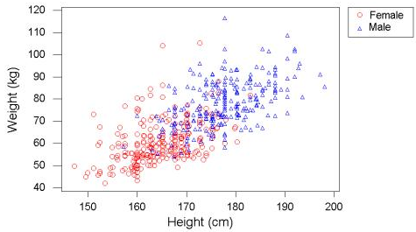
Figure X. Weight vs. Height by Gender
What can you infer from the diagram?
Credit: http://users.stat.umn.edu/~sandy/courses/8053/Data/Bodymeasurements/datasets.heinz.html

Slide 36
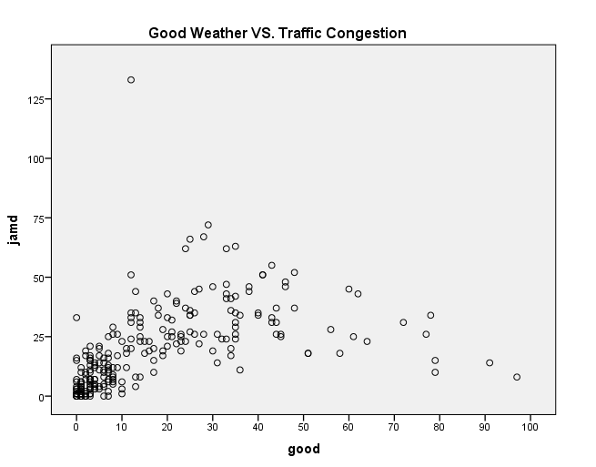
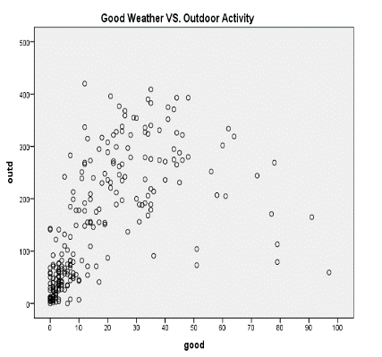
Figure 4 illustrates the positive correlation between occurrence of daily tweets mentioning good weather and traffic congestion and outdoor activities. Each data point represents a day. Since social media can reflect people’s opinions or thoughts to some extent, it can be inferred that there are more chances for people talking about traffic congestion when the weather is good and that people are more likely to do outdoor activities when the weather is good.
Credit: Tse et al. (2016) Social network based crowd sensing for intelligent transportation and climate applications

Slide 37
Reference
How to write a good scientific paper
http://www.lithoguru.com/scientist/science-writing.html
Incorporating Tables and Figures Effectively Into Your Writing
http://uq.edu.au/student-services/pdf/learning/effective-use-tables-figures.pdf
Sample data analysis report
http://www.monash.edu.au/lls/llonline/writing/information-technology/business-systems/3.xml
Almost everything you want to know about making tables and figures
http://abacus.bates.edu/~ganderso/biology/resources/writing/HTWtablefigs.html

Slide 38
Reference
Tips on effective use of tables and figures in research papers https://www.editage.com/insights/tips-on-effective-use-of-tables-and-figures-in-research-papers
How to design scatter plot https://visage.co/data-visualization-101-scatter-plots/
Introduction to Bivariate Data http://onlinestatbook.com/2/describing_bivariate_data/intro.html

